Slide 1
REPORT E-COMMERCE SALES

Slide 2
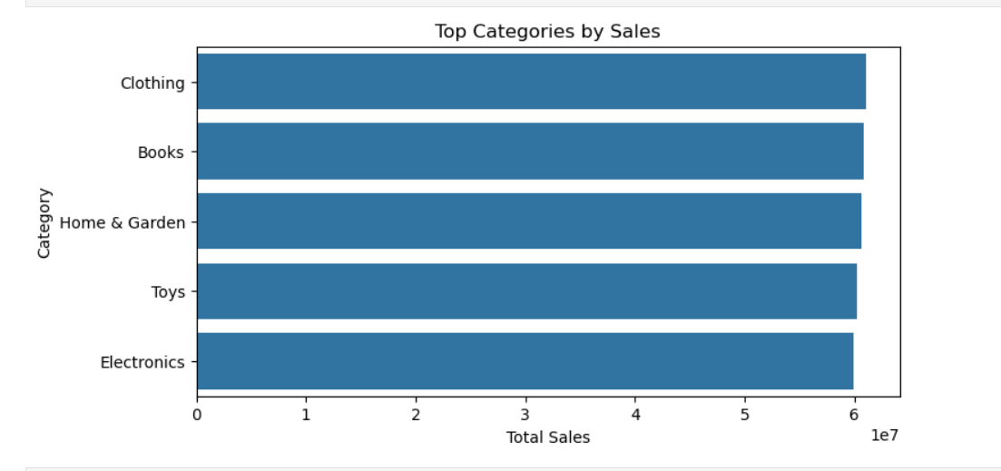
1. Focus on High-Growth Product Categories
Insight:
Sales analysis shows certain product categories consistently generate higher revenue and show upward monthly trends.
Business Opportunity:
These categories represent strong demand and customer preference.
Recommendation:
Increase inventory levels, introduce more SKUs, and run category-focused promotions to maximize revenue from high-performing products.

Slide 3
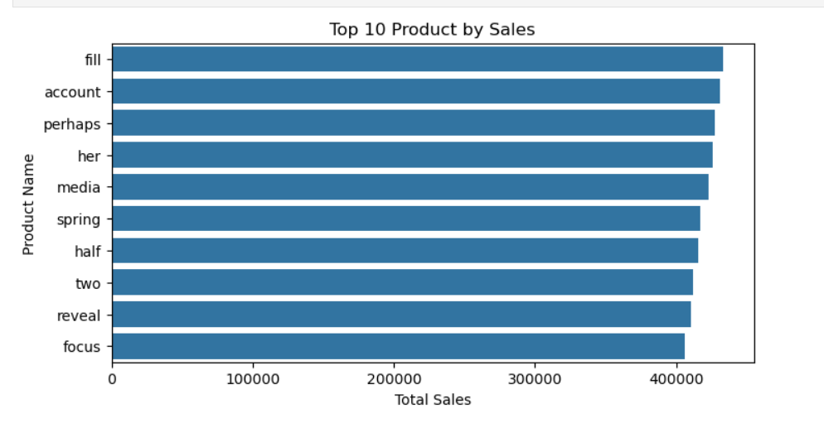
2. Improve Revenue via Upselling & Cross-Selling
Insight:
Customer purchase behavior shows common product pairings (e.g., main products with accessories).
Business Opportunity:
Customers are likely to buy complementary products when offered together.
Recommendation:
Introduce product bundles and personalized recommendations to increase average order value (AOV).

Slide 4
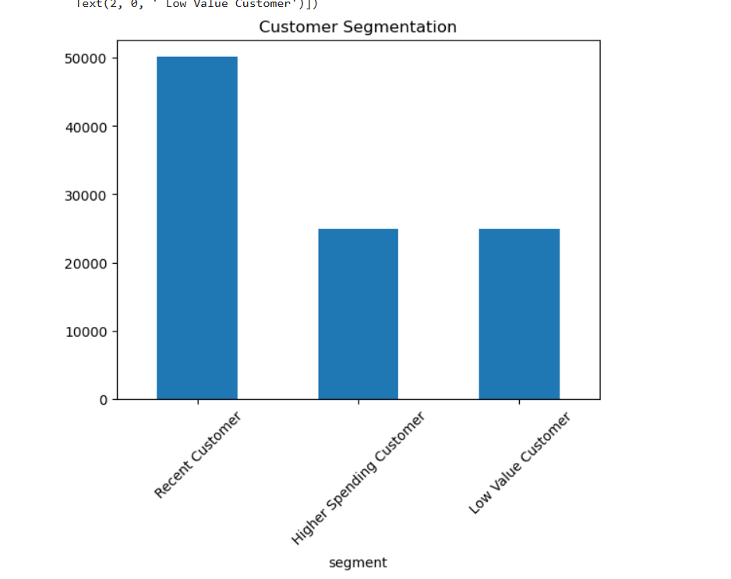
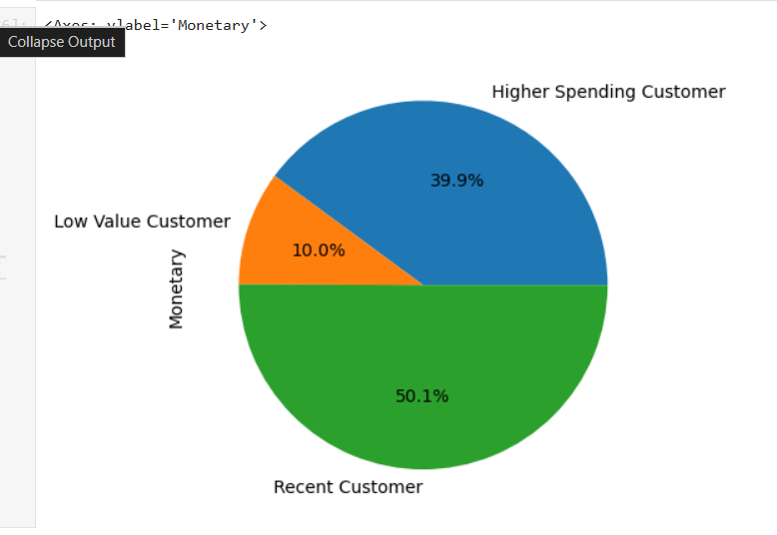
3.Reduce Customer Churn Using Retention Strategies
Insight:
RFM analysis identifies a segment of customers who have not purchased recently but previously showed high engagement.
Business Opportunity:
These customers can be reactivated at a lower cost than acquiring new ones.
Recommendation:
Implement win-back campaigns such as limited-time discounts, loyalty rewards, or personalized email offers.

Slide 5
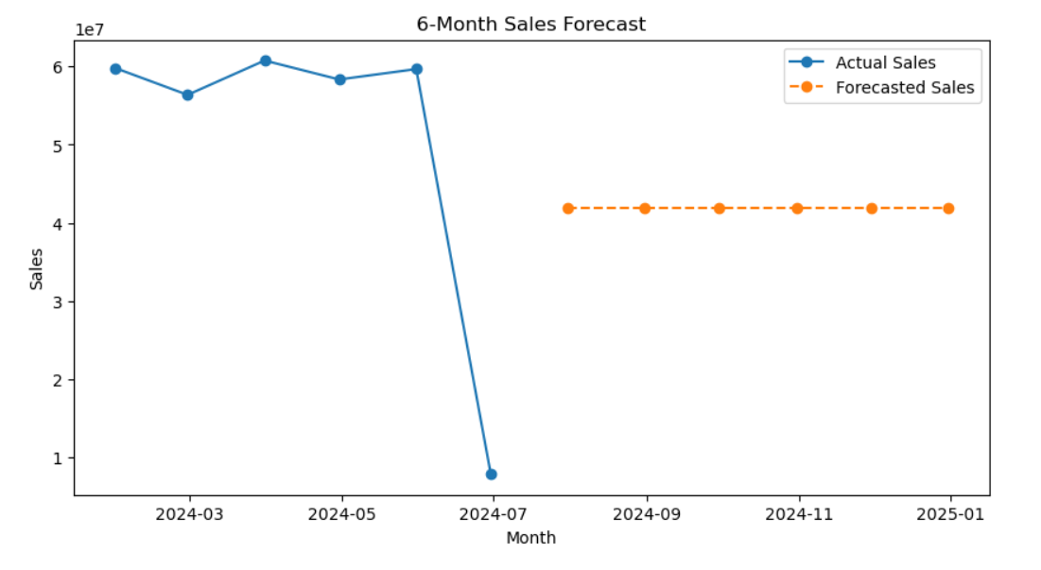
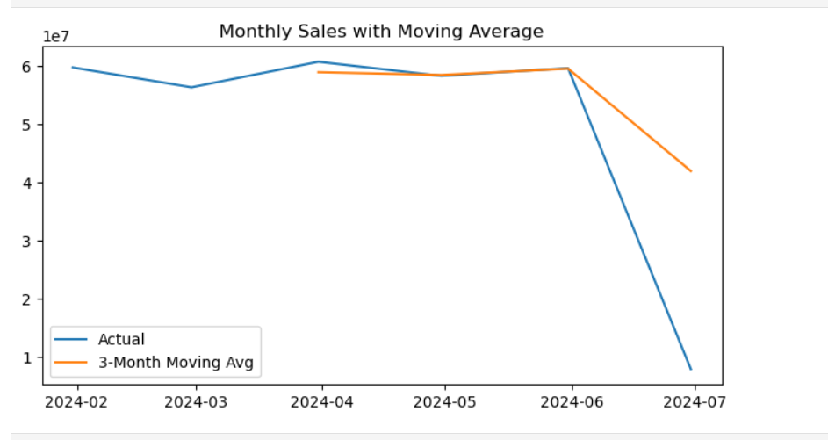
4.Plan Inventory Using Sales Forecasting
Insight:
Time-series analysis and moving-average forecasting predict stable sales over the next 6 months.
Business Opportunity:
Forecasting helps reduce stock-outs and over-stocking issues.
Recommendation:
Use forecasted sales estimates to optimize inventory planning and align supply chain operations with expected demand.

Slide 6
CONCLUSION
This analysis identifies key revenue growth opportunities through product optimization, regional targeting, customer retention, and demand forecasting. Implementing these data-driven strategies can help improve sales performance and customer satisfaction.

